Slide 1
Joveo
Research & Analysis

Slide 2
About
Global leader in programmatic advertising
Founded in 2016
Enables businesses to buy, manage and track recruitment media- At job sites, social, search marketplaces and the whole WWW
Uses advanced Data Science and ML to automatically regulate advertising
Provides centralized, real time insights
Powers more than 20 million jobs everyday

Slide 3
Funding
Series A - Feb 7, 2018 - $5M
Series B - Oct 1, 2019 - $12.5M
Both rounds funded by Nexus Venture Partners
Total 17.5M raised
HQ- Redwood City, CA

Slide 4
What is programmatic job advertising?
The use of technology instead of people for buying, placing, and optimizing job ads
Basically, programmatic recruitment makes sure your job ad is seen by the right candidates on the right sites at the right time
It is accomplished by the use of big data, targeted job ads, real-time bidding, and campaign optimization.

Slide 5
Benefits of Programmatic Job Advertising
Expanding your reach
Getting actionable insights
Saving money
Targeting ideal candidates
Strengthening your employer brand
Improving candidate experience
Retargeting potential applicants

Slide 6
Problem? (abstract)
No data-driven, centralized and automated way of running & regulating ads on numerous channels like social media, dedicated job-posting websites and other high traffic websites
No way to run, regulate and automate organic ads on social and search marketplaces
Bad application experiences leading to 80% candidate drop-offs

Slide 7
Products
Several products have been introduced to mitigate and solve aforementioned recruitment inefficiencies:
The MOJO Platform (complete solution)
For solving 1st problem:
MOJO Ad Exchange
MOJO Display Ads
For solving 2nd problem:
MOJO Social Networks
For solving 3rd problem:
MOJO Apply

Slide 8
Problem? (exhaustive)
High time, effort and budget consuming repetitive parts of recruitment process (that can be automated)
Availability of high number of channels to reach potential candidates
No centralized solution to track and maintain all the media advertising at one place

Slide 9
Problem? (exhaustive)
Low performance, high cost (11.3% of total revenue) advertising
Recruitment decisions being driven by intuition due to lack of data
Lack of uniform down-the-funnel metrics (beyond CPC and CPA) to make apples to apples comparison

Slide 10
Problem? (exhaustive)
High candidate rejection rates (low applicant quality)- lack of effective screening methods and inability to attract best candidates via channels
Low CTA conversion rates (drop off rate- 80% acc to Glassdoor)
Difficulty in finding right volume of relevant, high quality applicants for jobs, especially for hard to fill jobs

Slide 11
Problem? (exhaustive)
No way of retargeting highly suitable applicant drop-offs
Inefficient pricing by channels (CPC)
Scattered payment to different channels

Slide 12
Problem? (exhaustive)
No way of targeting active and passive job seekers via general high traffic websites
No way of automating and centralizing organic job ads on social and search marketplaces
There is also the problem of not even the candidate being aware of the best job fit for them

Slide 13
Situational problems
Due to the onset of Covid 19, high volume of applicants for some jobs has made screening resumes more difficult for already tight budget run recruitment teams and agencies
US- Unemployment benefits (up to $3600) made low wage workers not apply for lower-paying employment. This made (from oct 2020 to april 2021):
Avg click rates went -40%
Avg CPC went +130%
Avg CTA went -25%
Avg CPA went +215%
More needs to be done in less
This calls for an increased use of Programmatic Advertising

Slide 14
Industry insights
Employers with a Strong Employer Brand have a 43% lower CPH
Not only do 75% of candidates consider your employer brand before even applying for a job, they also compare it to your competitors
The higher a Glassdoor score, the more likely a user is to apply (2.5% increase for every additional “star” rating)
Programmatic job advertising currently represents about 25% of recruitment advertising

Slide 15
Industry insights
Currently, programmatic job advertising spending is about $350 million and this number is projected to grow
75% of candidates consider your employer brand before even applying for a job
86% of active job seekers begin their job search via their mobile devices
A study found that companies using programmatic job advertising are 2 times more likely to improve time to fill and 3 times more likely to improve the quality of their sources

Slide 16
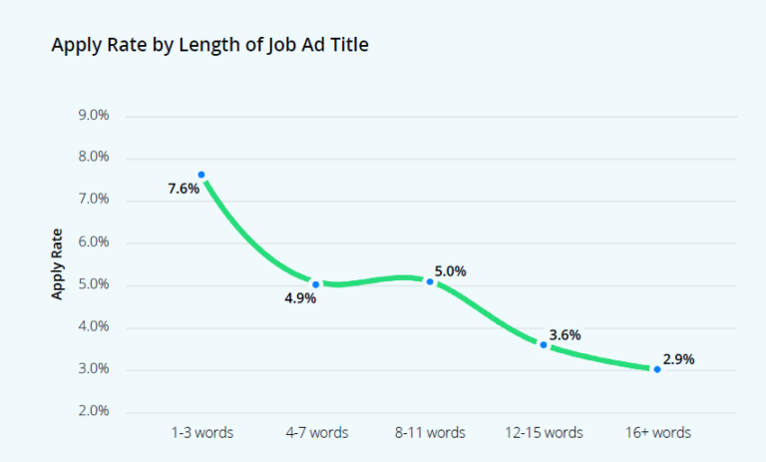
Other insights
Shorter job titles drive higher apply rates – According to Appcast’s research, job titles with one to three words have a 162% higher conversion rate

Slide 17
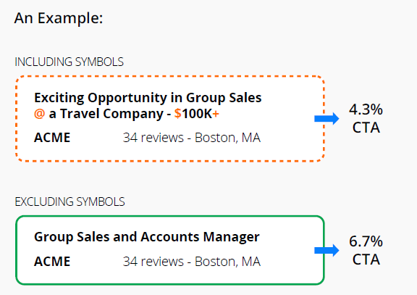
Other insights
Step away from the symbols:

Slide 18
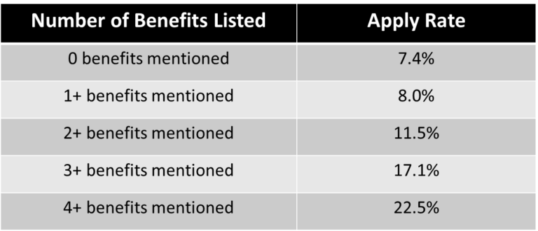
Other insights
Salary transparency for the win- Adding salaries to your jobs can increase conversion rate by 17%
More Benefits listed, more is the Apply Rate:

Slide 19
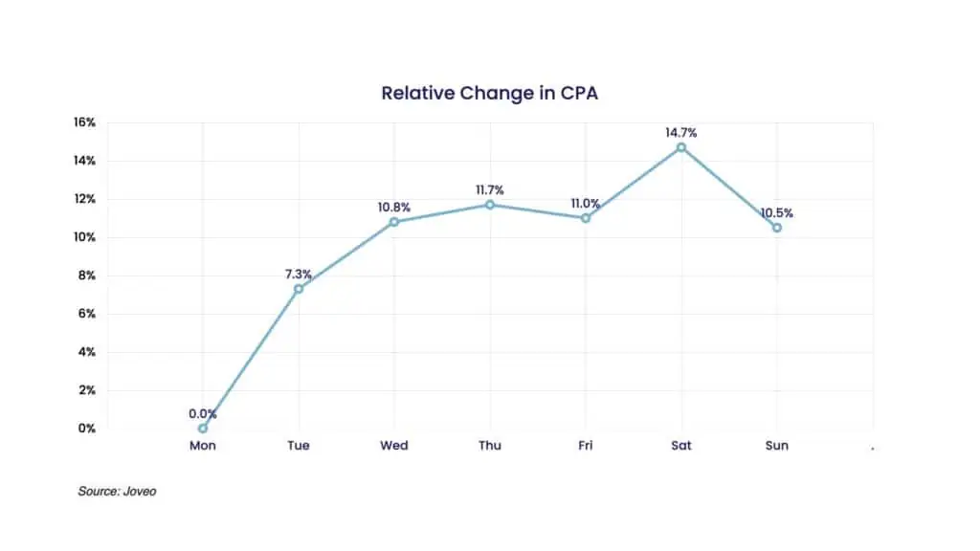
Other insights
Monday is the best day of the week to acquire applicants at a low cost per applicant (CPA), followed by Tuesday

Slide 20
Some direct competitors
Appcast
Talentify
PandoLogic (formerly RealMatch)
Smart Dreamers

Slide 21
Competitive advantage
The more time a customer spends on our platform, the better the performance becomes (since more data)
The above makes it hard for users to switch to other competitors
The above is a competitive advantage which allows for users to stick to our platform, thus improving the retention rate

Slide 22
Competitive advantage
(continued from previous slide...)
But our direct competitors in this space like SmartDreamers etc. have the same advantage
This calls for an increased spend in marketing, to acquire more recruitment agencies and companies to onboard with Joveo

Slide 23
Competitive advantage
Decreasing spend priority should be:
Acquire untapped and unaware market first
Then go for clients who are using competitor platforms
Considering the “more data better product” nature of the product, the company that acquires the most no of initial customers stands become a strong monopoly in the future, like Google

Slide 24
Key metrics
Time-to-hire
No of applications per relevant unit time
No of applications per position
No of high quality applicants per position
Clicks on job advertisement
Clicks on the application’s apply button

Slide 25
Key metrics
Cancellation of job ad
Cancellation of the application process
CTA (click to apply) conversion %
CPA (cost per applicant)
CPH (cost per hire)
CPA & CTH acc to the channel

Slide 26
Some features that I like
Track to hire: Tracking the consumer journey from click to apply to hire to make the best media buying decisions
Single invoice for all: Improves client UX
Retargeting: Helps in targeting quality applicants who dropped-off
Multi-apply: Helps in applying to other similar & suitable job roles in the time it takes to apply for one

Slide 27
Some features that I like
No ATS registration: Improves applicants UX and reduces drop-offs
Social sign-up: Makes data entry easy, reduces drop offs further
Automated resume creation: Applicants don’t need to make customized resumes for every job
Lookalike audiences: Using data on most qualified or successful hires to create lookalikes, optimizes future hiring

Slide 28
Some product questions (that I have)!
There are some product questions that I have, which I think can add value to the current Joveo’s product:
Is A/B ad testing feature available for clients?
Which countries do we target the most? Which ones offer a good opportunity but we haven’t tapped enough?
Is cross-device retargeting available?
I read about a VR ad platform called as Omnivirt. Do we offer offer omnivirt on our platform?

Slide 29
Some product questions (that I have)!
Is the applicant’s info automatically saved up until the point they filled it, in case they revisit it via the same or different channel?
Can we negotiate CPH deals with media channels? If yes, what conditions should be met?
Can I change the ads according to the user? Because different messaging resonates with different groups of people, and every company hires from freshers to senior roles

Slide 30
Some product questions (that I have)!
Do we have more blue collar job seeking clients or the other way round?
Do we use data from one customer to optimize ads for other customers?

Slide 31
Some product questions (that I have)!
MOJO Apply is a GREAT product and I could easily empathize with the problems, being a job applicant myself!
Acc to a research, companies with a strong employer brand see a 43% decrease in cost per hire on average
Strong employer brand also helps hire a candidate at a cheaper salary, further decreasing the CPH
MOJO Apply helps to improve employer brand
Considering that no of 43%, what other products can we introduce to bolster employer brand?

Slide 32
A word from the CEO
Joveo is the first truly programmatic recruitment advertising platform which is simple, transparent and easy to use. Our mission is to work with job boards, agencies, RPOs and staffing agencies to take the pain out of job advertising.
We are not an agency or a publisher/job board and will never be one. We are a pure-play technology company.
Harnessing machine learning, our platform connects our clients with the right candidates for the right roles, faster and more efficiently than ever before.
Kshitij Jain, CEO, Joveo

Slide 33
Thanks!!
For patiently going through this long PPT :)

